Slide 1
Self Defense Test
Hilltop High School
2011

Slide 2
# 1 What would be the best response in this situation?
One night you leave the mall late and find yourself in a parking garage with no other people around. You see a strange man lurking in the shadows. He seems creepy. He starts to approach you. What should you do?
Walk fast back to the mall while keeping an eye on him.
Keep walking to your car with your eyes down on the ground.
Dig in your purse for your cell phone.
Engage the man in a conversation.

Slide 3
# 2 What would be the best response in this situation?
You are walking in the park for fitness. Suddenly a strange man jumps out of the bushes behind you and grabs you in a “under the arms bear hug hold.”
Drop your weight.
Strike the back of his hands with your knuckles.
“Spin cycle” – engage in back elbow strikes to the attacker’s face.
All of the above.

Slide 4
#3 Which skill related component of fitness is described in this scenario?
Someone grabs your wrist. You quickly step to the outside and rapidly swing your arms with a chopping motion to release the grip.
Aerobic capacity and BMI.
Muscular endurance and speed.
Agility and coordination.
Flexibility and strength.

Slide 5
#4 Which skill related component of fitness is described in this scenario?
Someone puts an unwanted “front bear hug” hold on you. You immediately drop down (change levels) and push with all of your might on the attacker’s hips to create space.
Aerobic capacity and BMI
Flexibility and Balance
Power and Coordination
Muscular Endurance and Strength

Slide 6
Match the word to the definition located in the text box. Write the answer on your answer sheet.
A mechanical advantage or power gained by using a lever.
Body parts working together for common purpose.
Strength or power exerted upon an object.
Amount of time it takes you to move once you realize the need to act.
Coordination
Reaction time
Leverage
Force

Slide 7
# 9 If someone grabs you, what is the one thing you do NOT want to do?
Turn arm in a half circle.
Pull away in a tug of war match.
Step to the outside of your attacker.
Use second hand to help with strength.

Slide 8
# 10 The picture below is an example of which biomechanical principal?
Leverage
Proprioception
Rotary Motion
Aerobic Capacity

Slide 9
Identify the leverage focus points for the following escape options.
Two- hand wrist grab.
Head lock.
Bear hug: from behind/over the arms.
Front choke.
Swing arm high, drop weight as you lower elbow onto attacker’s wrists.
Drop weight/flair arms.
Pull wrist that is choking you while pushing attacker’s chin away from you.
Step to attacker’s outside, swing arms and chop the wrist.

Slide 10
#15 What is the FIRST thing a person should do when put in a head lock?
Drop weight.
Turn chin away from attacker towards attacker’s elbow.
Turn chin towards attacker’s arm pit.
Stand up.

Slide 11
# 16 Why is it important to create space (or a gap) while trying to escape from an attack?
Allows you the opportunity to use leverage to release the hold on you.
Allows you the opportunity strike attacker’s vulnerable spots.
Allows you the opportunity to breath.
All of the above.

Slide 12
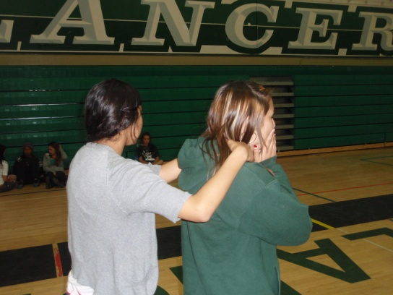
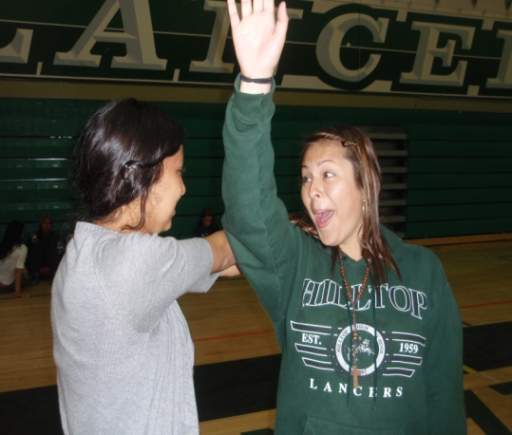
# 17 Choke Escape: Why is it important to raise the arm up, turn into the attacker, and drop your weight as you strike your elbow on the attacker’s wrists?
Maximize leverage and force to improve chance of attacker releasing the grip on your throat.
It is an advanced dance move likely to ensure selection on the next episode of Dancing With the Stars
Improves cardiovascular endurance.
It provides the opportunity to determine if your attacker is serious about harming you.

Slide 13
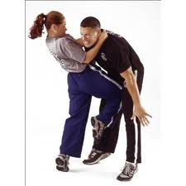
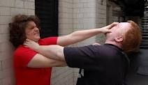
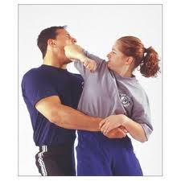
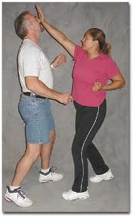
#18 In self defense, why might it be necessary to engage in the responses below?
The attacker is stronger than the victim.
Attacker means to do harm.
The victim is smaller than the attacker.
All of the above.

Slide 14
# 19 Why is it important to practice self defense techniques over and over again?
Quickens reaction time.
More effective use of leverage.
Ability to identify dangerous situation faster.
All of the above.

Slide 15
# 20 Regardless of the scenario, some basic principles of self defense should always be kept in mind: A. There is a start, middle and end of every attack: look for the openings. B. Use leverage instead of strength. C. Strike vulnerable areas of your attacker. D. All of the above.

