Slide 1
HHS Lacrosse Assessment

Slide 2
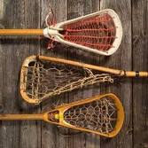
1. History of Lacrosse
Lacrosse is believed to have started in North America with:
The British
Native Americans
Vikings
The French

Slide 3
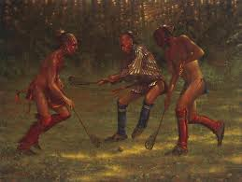
2. History of Lacrosse
In the early days of Lacrosse the game was usually played with how many players?
10
12
16
Hundreds

Slide 4
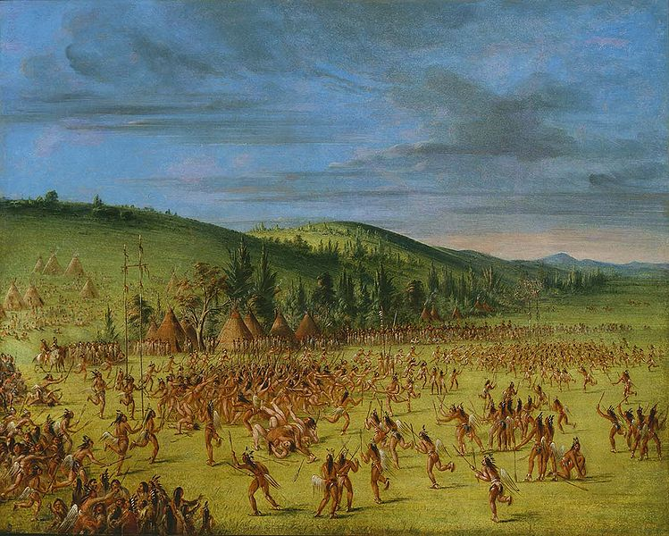
3. History of Lacrosse
It was not uncommon for Lacrosse to be played over an area:
The size of a basketball court.
The size of a soccer field.
The size of the Super Bowl field.
Many miles long and wide.

Slide 5
Lacrosse Vocabulary: Matching
4. Intercept
5. Cradle
Marking
Pivot
Rotate directions with one foot planted.
Guarding an opponent.
Carrying the ball in the net.
Catching the ball in the air before it reaches the other team.

Slide 6
Lacrosse Passing Biomechanics: Matching
Leverage
Opposition
Rotary Motion
Force
Rotating hips when passing to generate speed.
Quickly snapping the wrist of the top hand and pulling the bottem of the stick towards you.
Feet in a stagger position, move weight from back to front foot.
Placement of hands on stick to generate power.

Slide 7
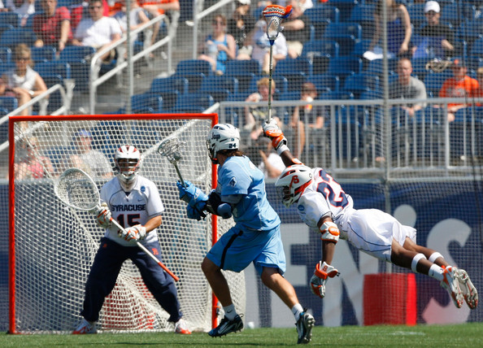
12. Which of the below would a person need to be able to dodge opponents, weave in and around defense to score a point? (1.3)
Reaction Time
Agility
Speed
All of the Above

Slide 8
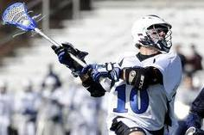
13. In order to pass the ball for distance, which biomechanical principles should be followed?
Leverage
Opposition
Rotary Motion
All of the Above

Slide 9
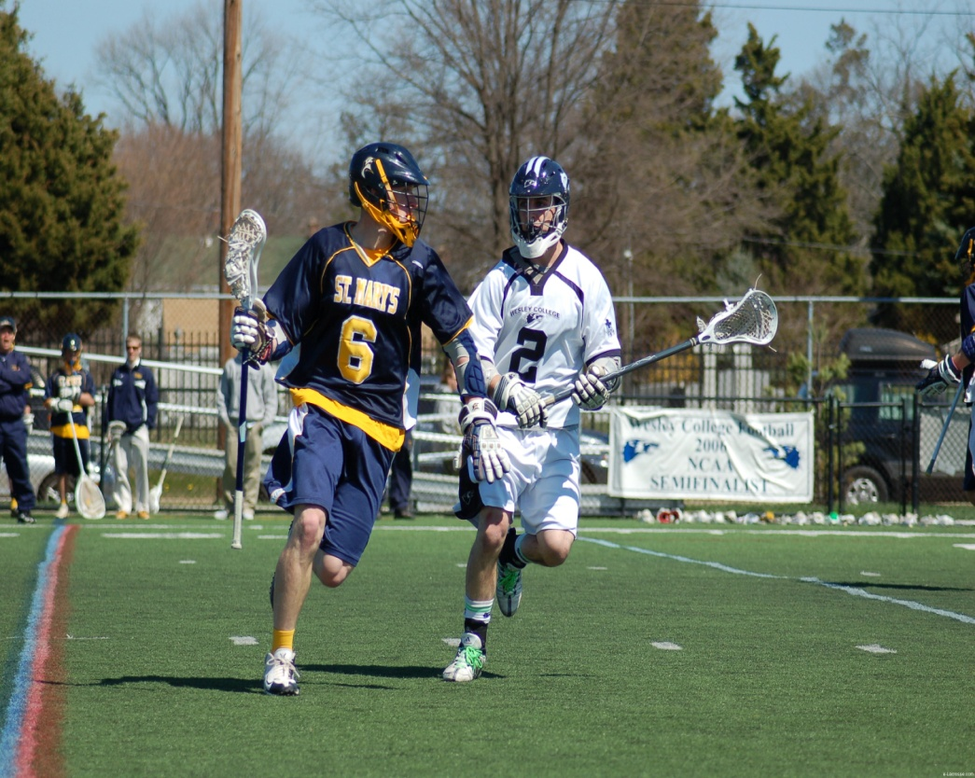
14. Which of the below would be an appropriate tactic for DEFENSE?
Marking
Move to Open Space
Cradle
Face Off

Slide 10
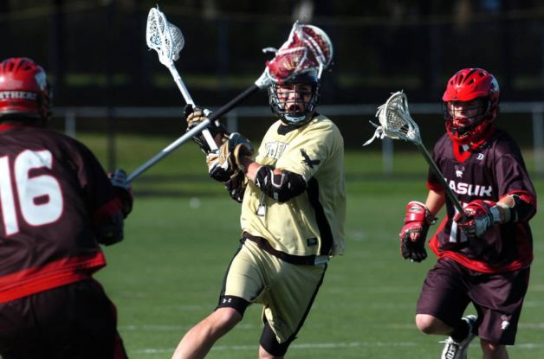
15. Which would be an appropriate strategy for OFFENSE?
Marking
Move to Open Space
Checking
Face Off

Slide 11
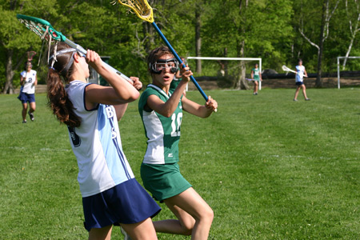
16 Which of the below best describes how PROPRIOCEPTION could help a Lacrosse Player? (1.7)
The player feels that the ball is about to fall out of the net and makes an adjustment
The player watches a video of her shot to perfect form
The player asks her friend to provide tips for her passing skill
All of the above

Slide 12
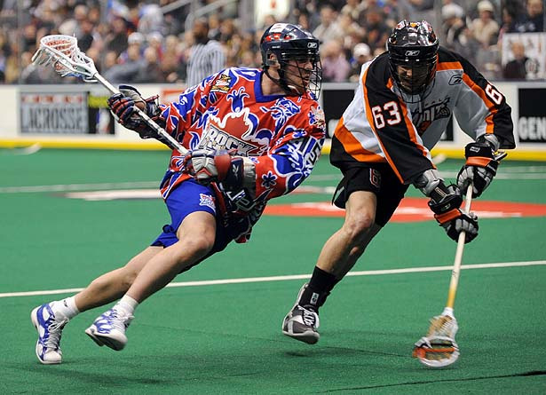
17. Which training plan below would work best for a Lacrosse Player?
Agility drills, plyometrics, lots of cardio, resistance training for speed and stretching.
Long distance running, power lifting for bulk.
Push Ups and stretching.
Power Lifting and Agility Drills.

Slide 13
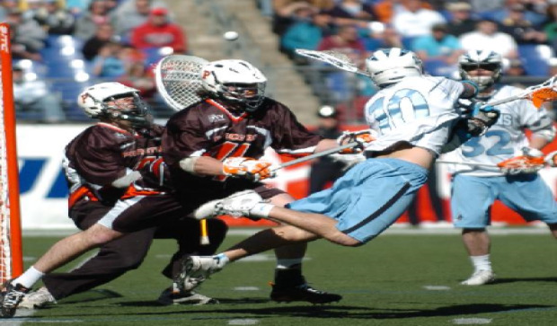
18. A Lacrosse Player would need which of the below to be successful?
Motivation
Determination
“Can Do” Attitude
All of the above

Slide 14
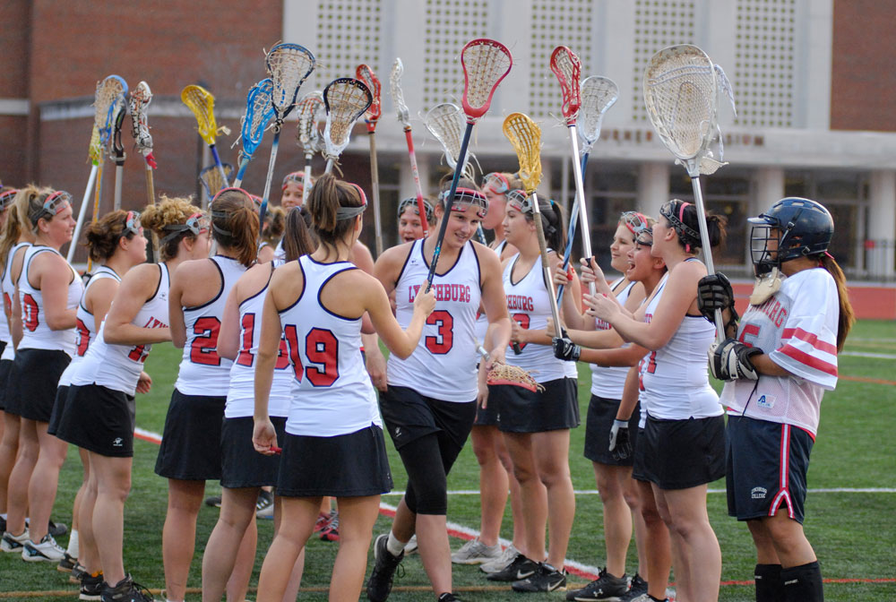
19. Identify the leadership skills below needed for Lacrosse.
Helps a novice learn how to play.
Encourages teammates.
Helps set up and put equipment away without being asked.
All of the above.

Slide 15
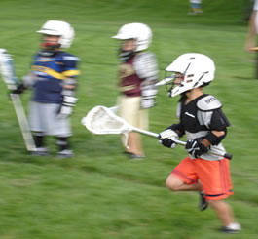
20. How would you adjust a Lacrosse game for a group of 8 year old kids?
Have them play with a softer ball.
Use smaller sticks.
Simplify the rules.
All of the above.

