Slide 1
Football Unit Test
By Dr. Kim Butler
Hilltop High School
(2014)

Slide 2
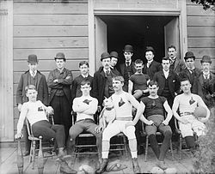
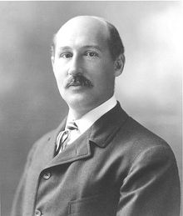
History of Football
Walter Camp = Father of American Football
Starting moving rules away from Rugby: “Line of Scrimmage”
Glen “Pop:” Warner = Helped take advantage of the new “Forward Pass”.

Slide 3
History of Football: “Pudge”
William “Pudge” Heffelfinger
Born: Dec. 20, 1867
Played for Yale
Exceptional Athlete
At 6’3” 200 pounds, Heffelfinger was especially big for that era and towered over his opponents.
November 12, 1892 paid $500 to begin “professional football”

Slide 4
Basic Rules
Football played on a rectangular field 100 yards long.
Each team has 11 players on the field at a time.
Game begins with a kick off.
When a team has possession of the football they are on offense. Object is get the football past the other team’s end zone to score a touch down.
Teams need to advance the football 10 yards within four downs (attempts). If they can’t do this than the ball is handed over to the other team.
On the fourth down the opposition has two options: punt or pass. The punt option is where they try and kick the football between the field goal posts. The pass option is the same as downs 1-3 .

Slide 5
Scoring
Field Goal without a touch down = 3 points
Touch Down = 6 points
Extra Point after Touch Down with a Punt= 1 point
Extra Point after Touch Down with 1 play = 2 points
Safety (bumble the ball behind own end zone) = 2 points

Slide 6
Basic Strategies
Offense
Defense
Quarterback calls plays.
Team can “run” the ball where they earn small but steady gains.
Team can “pass” the ball where quarterback calls plays and receivers run down field and catch passes, sometimes for long distances.
Football defenses today run numerous plays and formations throughout a game. T
One of the main strategies of football defenses against the pass is the blitz. This is when a player that would normally not rush the passer, rushes the passer
The advantage of the blitz is that a football team is more likely to get a sack or to give the quarterback less time to throw the football. The disadvantage is that there are less players downfield to tackle a runner or to cover receivers. A defensive football strategy that is used late in games is the prevent defense. This usually means the defense has an extra defensive back and that the defenders are all staying behind the receivers.

Slide 7
Cues for Punting a Football
Laces up, nose down.
Toss ball in front.
Extend the ball out.
Step – step – drop - kick

Slide 8
Cues for Passing a Football
Elbow up and lead with throwing elbow
Legs shoulder width apart and opposite foot aimed towards target
Step towards target
Snap wrist and follow through

Slide 9
Cues for Receiving a Football
High catches, fingers up.
Low catches, fingers down.
Watch the ball, not the defender.
Reach with your arms and give with your hands.

Slide 10
Cues for Football: Snap
Wide, balanced stance.
Hands wide across ball.
Pass the ball between your legs to the quarter back.

Slide 11
Player to Player Defense
Guard one player in defense.
Follow the player where ever they go.
Try to block a pass before it is caught.
If ball is caught, quickly tag the player.
Be in a position where you can see the quarterback and your player all the time.

Slide 12
Football Receiver Patterns

Slide 13
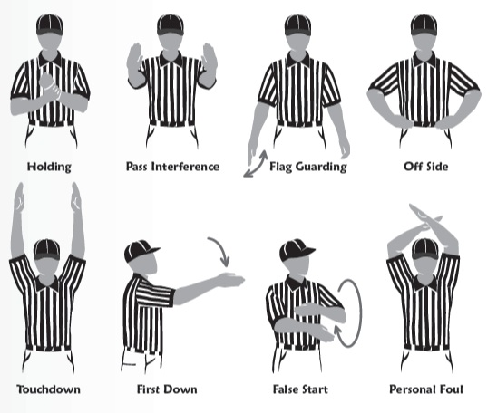
Football Referee Signals

Slide 14
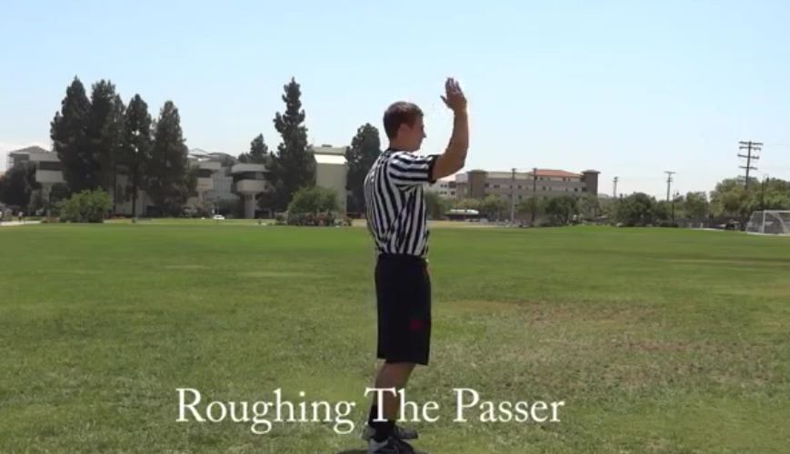

Slide 15
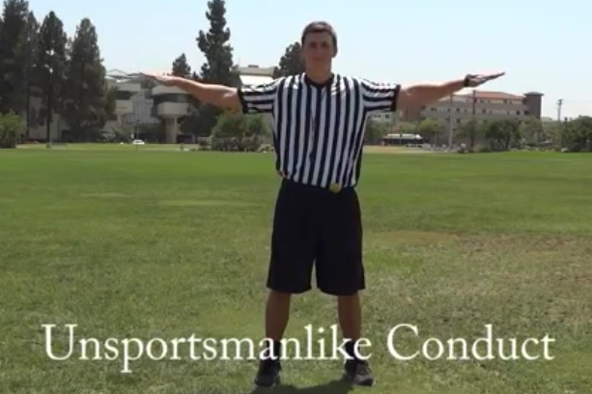

Slide 16
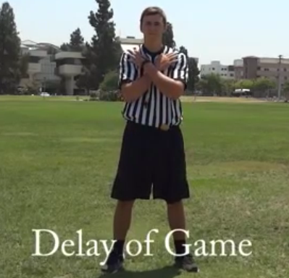

Slide 17
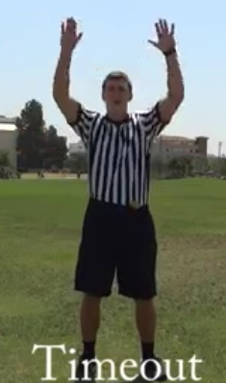

Slide 18
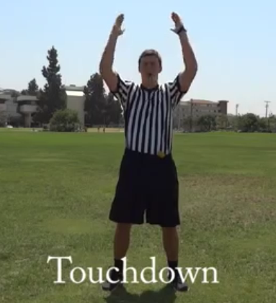

Slide 19
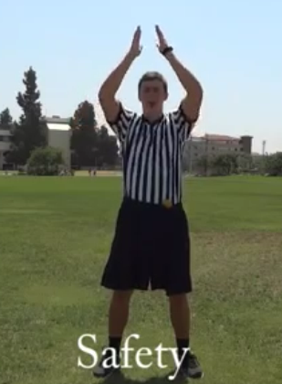

Slide 20
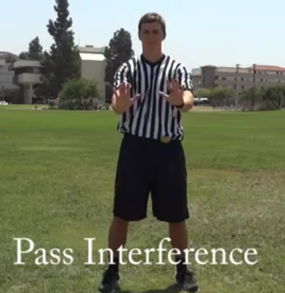

Slide 21
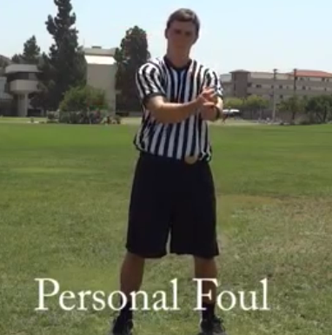

Slide 22
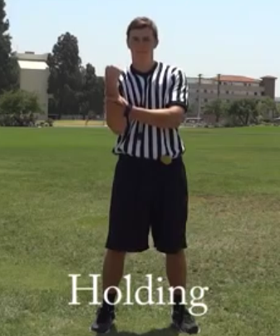

Slide 23
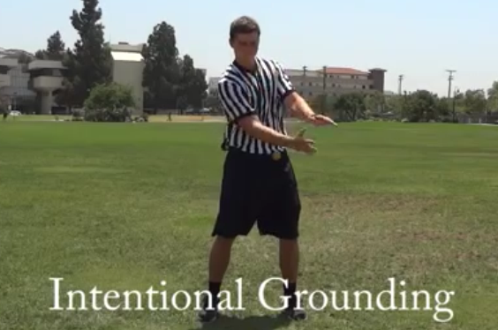

Slide 24
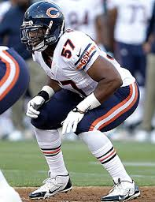
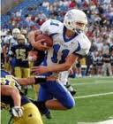
Balance
An even distribution of weight enabling someone or something to remain upright and steady.

Slide 25
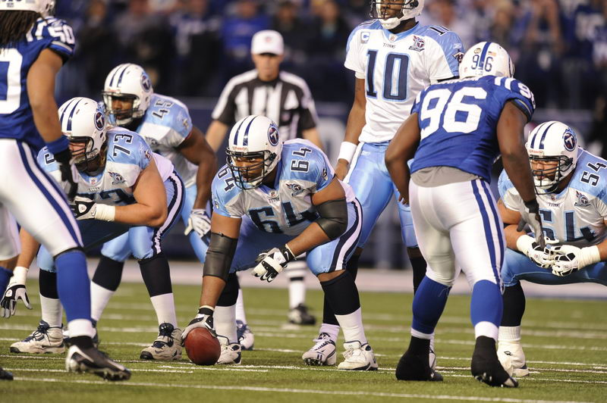
Reaction Time
The time that elapses between a stimulus and the response to it.

Slide 26
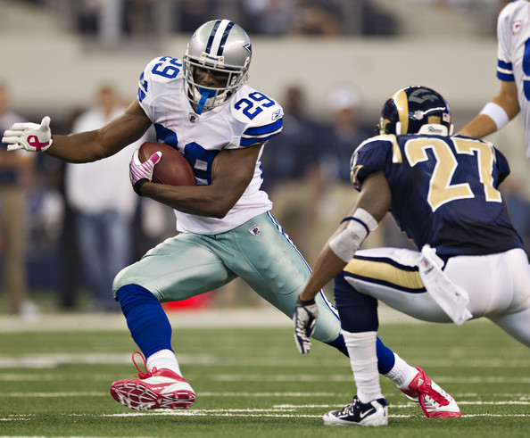
Agility
The ability to change directions quickly.

Slide 27
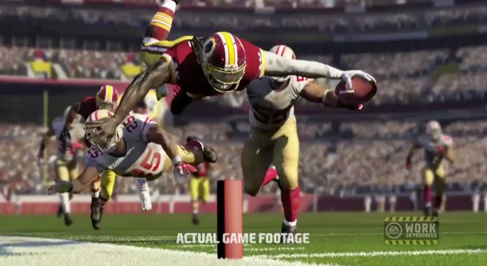
Coordination
The organization of the different elements of a complex body or activity so as to enable them to work together effectively.

Slide 28
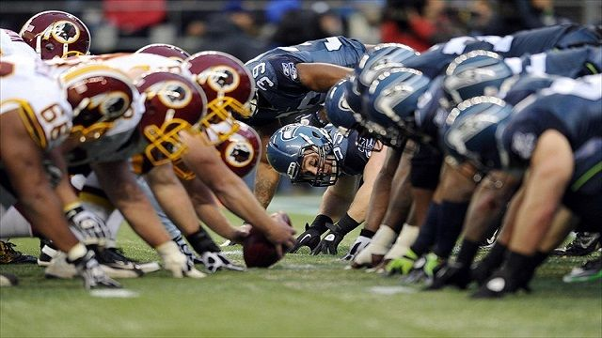
Explosive Power
Power by definition is the rate at which we can apply maximal force against an external load or surface.

Slide 29
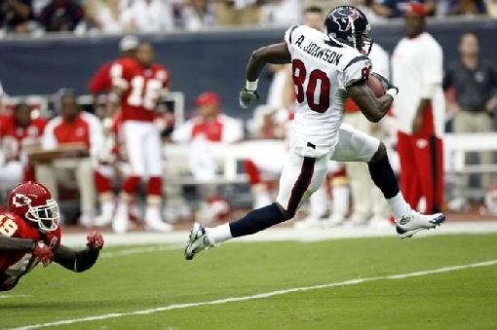
Speed
Time an object or person travels across a distance.

Slide 30
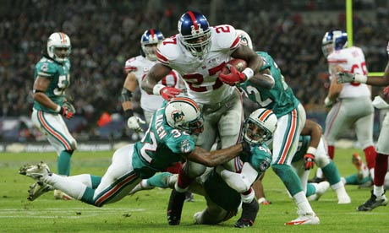
Force
A push or a pull applied to an object or person, measured in pounds or newtons.

Slide 31
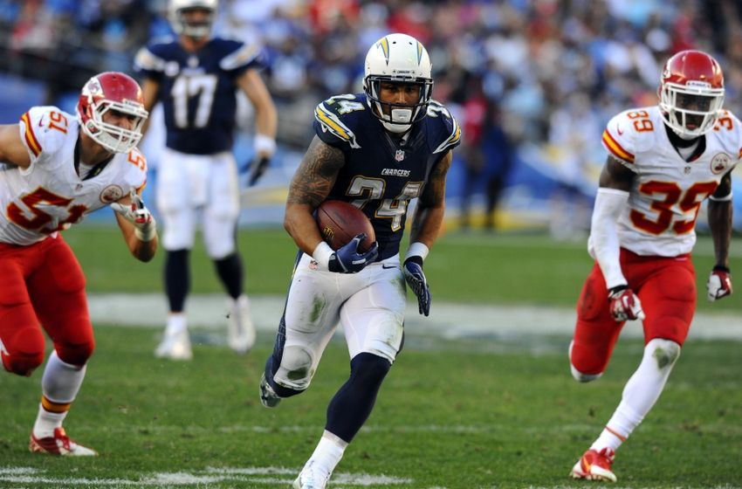
Inertia
The tendency of a body at rest to remain at rest or of a body in straight line motion to stay in motion in a straight line unless acted on by an outside force.

Slide 32
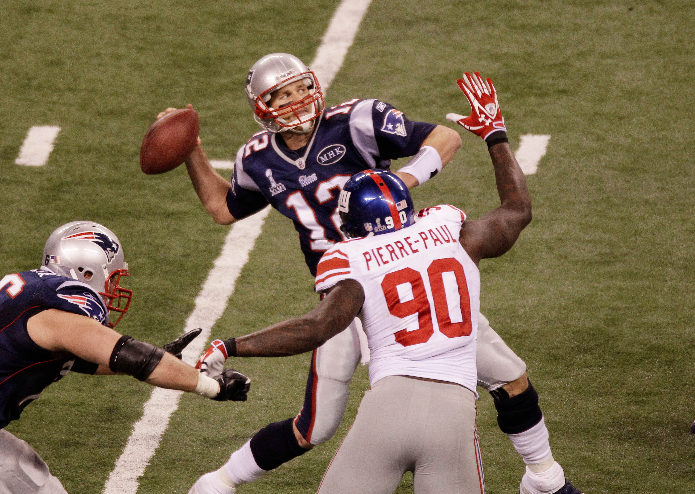
Rotary Motion
The act of rotating as if on an axis; "the rotation of the dancer kept time with the music"

Slide 33
Opposition
The use of body parts on opposite sides of body to increase force and power.

Slide 34
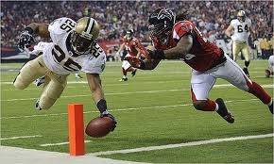
Proprioception
The ability to sense the position and location and orientation and movement of the body and its parts.

Slide 35
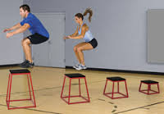
Sports Specific Training: Plyometrics
A type of training designed to produce fast, powerful movements, and improving performance in sports.
Jump higher.
Run faster.

Slide 36
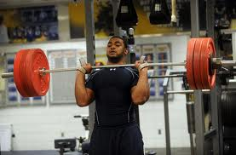
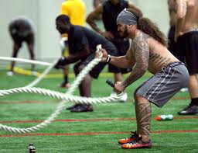
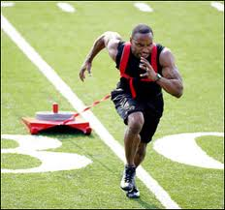
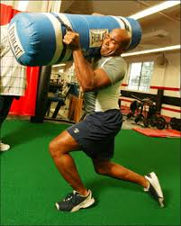
Sports Specific Training: Combination Strength and Endurance
Weight and reps (depending on position).
Combination of plyos, strength, endurance and sprints.

