Slide 1
Bodybuggs in Physical Education: A PEP Grant Story
Presenters:
Dr. Kimberly Butler
Danielle Cherry
Allison Fletcher
Room: Room 211
Saturday February 26
Time: 8:30 - 9:30 am

Slide 2
Presentation Focus Points
Attendees who participate in this session will be able to answer the following questions:
What is a bodybugg?
Why use bodybuggs in a physical education class?
How do students and teachers feel about using bodybuggs?
How to set up bodybuggs for a class.
How to apply for a PEP grant with bodybuggs.

Slide 3
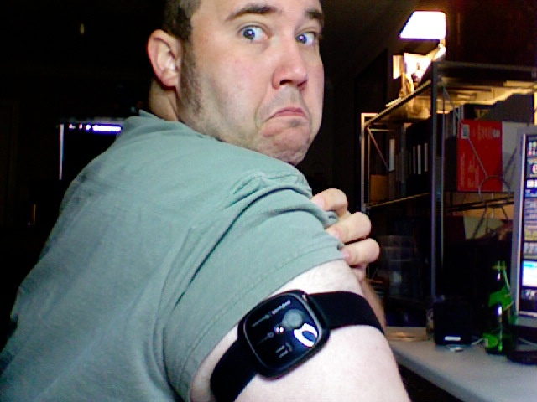
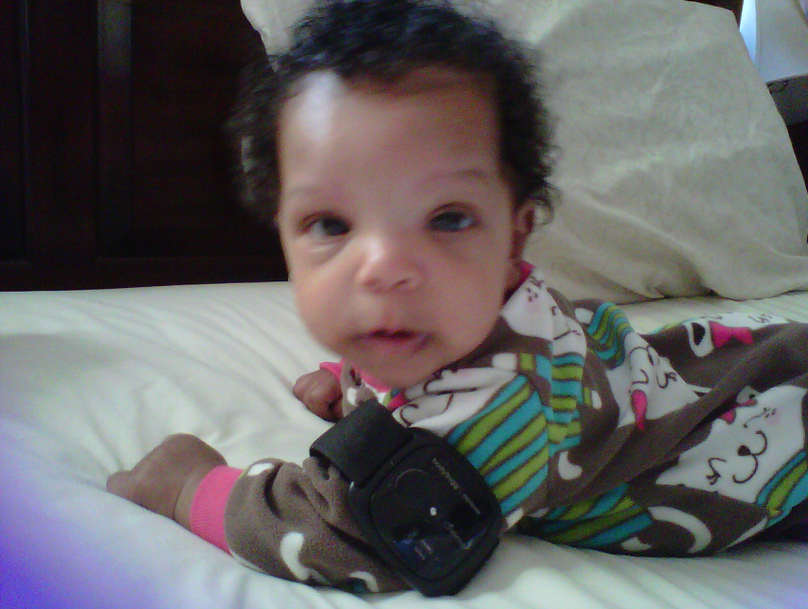
Meet bodybugg
The bodybugg works by keeping an accurate daily record of calories consumed vs. burned making it easier to manage your weight.

Slide 4
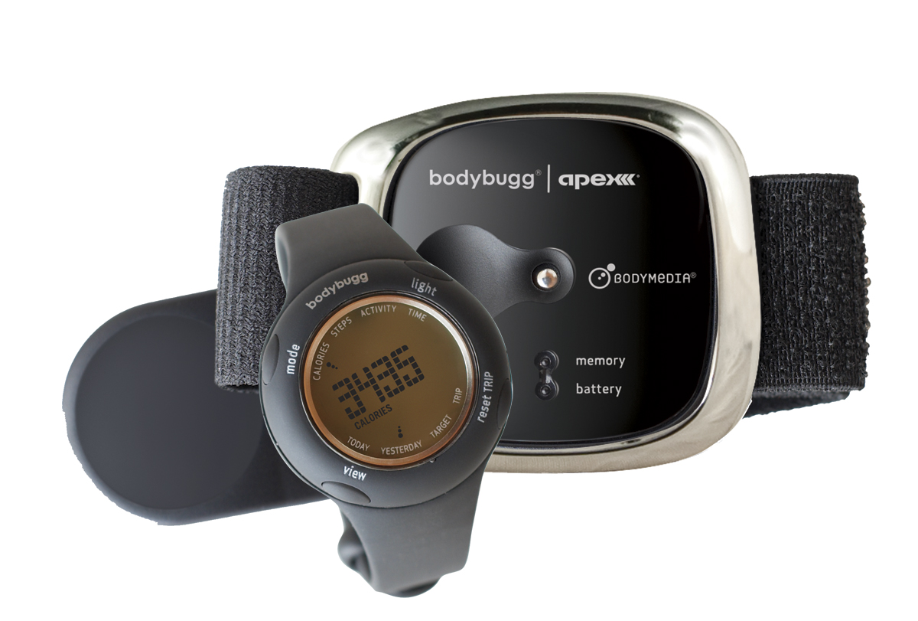
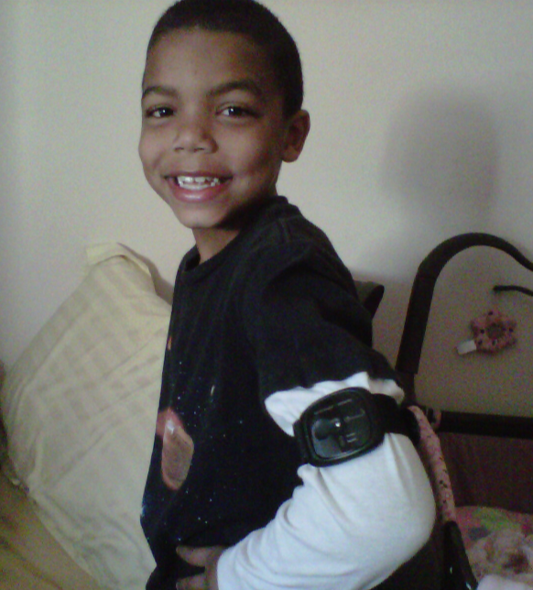
Why bodybuggs?
Sweetwater’s PEP grant identified these needs:
Many students not healthy based on Fitnessgram data.
Students not provided a standards based physical education curriculum.
Students who failed the Fitnessgram enrolled in an intervention course: Fitness for Life
Challenging to motivate students to prepare for Fitnessgram.

Slide 5
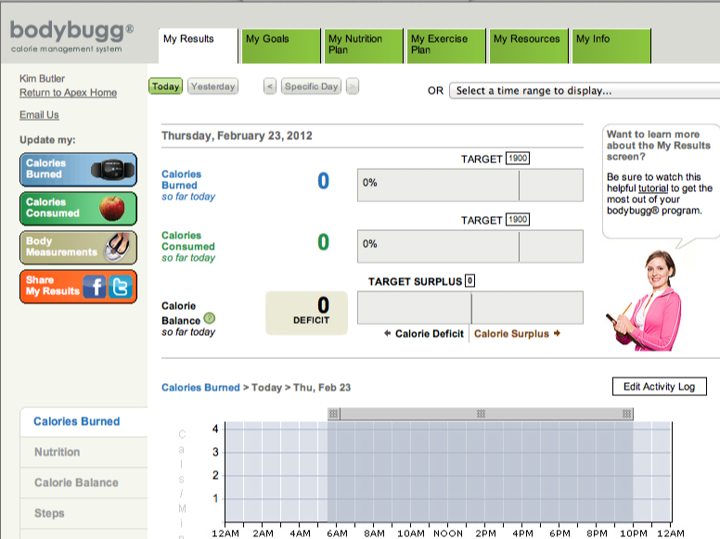

Slide 6
Teachers’ Impressions of bodybuggs
Positives
Negatives
Least likely students are highly motivated for activity.
Students learn how to self manage caloric balance.
Supports physical fitness knowledge standards and curriculum.
Indication of parental involvement is favorable.
Strong indication of student weight loss.
Sustainability, indication that students are keeping the weight off.
Time intensive to set up.
Software challenges (Java, bodybugg installer)
Teachers need to have some personal familiarity with bodybugg.
Teachers need some technology skills, particularly with the internet.

Slide 7
Student Reflection
wellmy first week was amazing.
i really enjoy wearing the bodybugg! it helps me make sure i burn enough calories and eat right.
i always want to meet my goals each day so i try to do as much as i can if i have time between my studies and chores. i dont know if i should be sleeping with it. sometimes i do beacuse i forget to take it off and surprisingly i dont feel it when i sleep.
i dont have any problems with it except for re-syncing it every morning, which takes forever to do!
i want to do my best to lose wait and keep it off and i am willing to work harder...well until i cant take it anymore :P
i am even eating healthier and planning to do a healthy-not-starving-myself-diet with L, H, and D and H and i are planning to do work outs together to modivate each other. i cant wait to see my progress throughout the weeks:)
(By end of program student lost 5 pounds)

Slide 8
Student Reflection
I was surprised about bodybuggs because it actually makes me exercise more and eat less because it makes me consious (sic) about the calories I burn and take.
Bodybuggs are like a tool that will help you me more fit by controlling the calories you eat and the calories you burn.

Slide 9
Student's Impressions of bodybuggs
Positives
Negatives
Shows number of calories you burn in a day.
Calculates daily steps.
Motivates you because you can see calories burned.
Helps to better understand calorie management and that I need to burn more than I eat every day!
The website is very useful and I liked that it was easy to log the food.
Does not always sync well with the watch which makes it difficult to see your results.
Took time to input food on computer.
Uncomfortable to wear.
I didn’t like when it made sounds during class when I reached a goal because it was embarrassing
Website was confusing

Slide 10
Let’s Move In Schools
Hilltop High joined 8 other school sites for the AAHPERD convention in San Diego, 2011.
Hilltop High students were active using the bodybuggs and joined Carl Lewis on the stage for Skillastics.

Slide 11
Camp Stevens

Slide 12
SPARK: B-buggs and map challenge

Slide 13
SPARK HS: ASAP

Slide 14
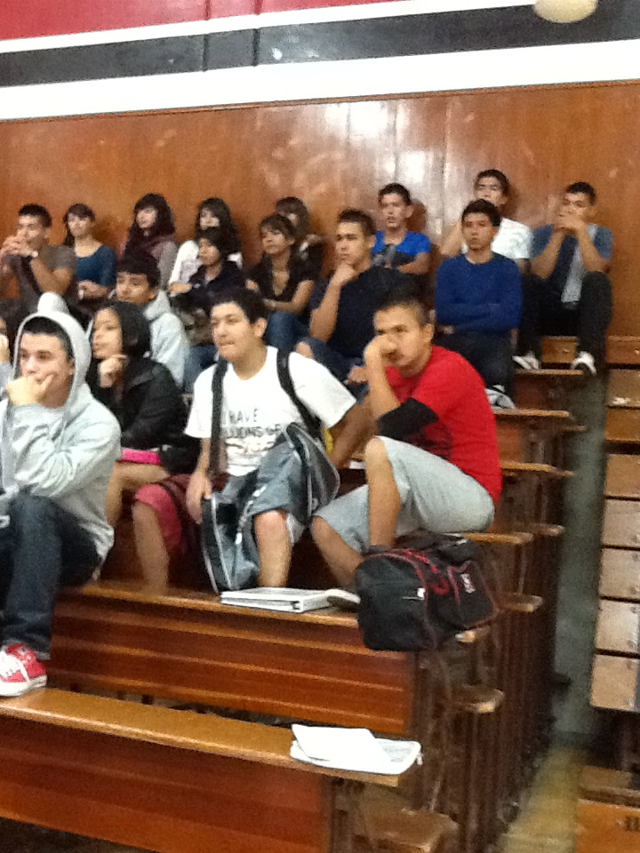
How to set up bodybuggs for a class.
Determine where students will use computers.
Download latest version of JAVA and bodybugg installer program on all computers students will use

Slide 15
How to set up bodybuggs for a class cont.
Have students complete a parent permission form prior to checking bodybuggs out (example available on www.sweetwaterpe.org)
Work with the library to have students check out bodybuggs. Helpful with bar coding and keeping track of the devices.
Create student accounts prior to distributing bodybuggs to students (http://myapexfitness.com).
Tip 1: UN = kimbutler (no space or caps), PW = school mascot (Lancers1)

Slide 16
How to apply for a PEP grant with bodybuggs.
Focus:
Need
Involve all Stake Holders
Sustainability
Visibility

Slide 17
PEP Focus # 1: Establish Need
Fitness Level of Students
Are students healthy based on Fitnessgram data when, comparing results to state and county results?
Curriculum
Is the curriculum standards based and inline with high high quality physical education practices?
Training
Have teachers been trained with the new high quality physical education practices?
Equipment
Do your teachers have the equipment they need to provide a quality physical education program?

Slide 18
Example – Establish Need
2011 State Physical Fitness Data:
50% of Chula Vista Elementary District 5th grade students were scored as overweight and 36% OBESE
These students are now 6th graders, and data indicates percentage will continue to rise…these students will enroll in Sweetwater beginning 2012!
33% of Sweetwaer 7th Graders and 26% 9th graders were scored as obese.
Without interventions, looking at the data from the younger students, obesity rates are expected to rise for Sweetwater students.
Direct correlation between physical fitness and academic achievement: profound implications for “program improvement” and “low performing” status of schools.

Slide 19
Need Example – Data Driven
 | Body Composition |  | Aerobic Capacity |  | Overall Pass Percentage
 | SUHSD | STATE | SUHSD | STATE | SUHSD | STATE
*2011 | 59 | 59 | 73 | 62 | 70 | 50
2010 | 71 | 71 | 80 | 64 | 76 | 66
2009 | 69 | 70 | 78 | 63 | 75 | 65
**2008 | 64 | 70 | 60 | 61 | 59 | 63
 |  | 2011- First year new PFT protocols in place (body composition impact on aerobic capacity scores).
 |  | 2008 - SUHSD identified needs for improvement for PEP grant

Slide 20
PEP Focus # 2: Sustainability
District support for physical education
Board policies
Student enrollment in courses
Support when parents/students complain
Allow time for physical education in-service
Culture of valuing physical education
Wellness policies
Change the culture of schools
Physical education curriculum
Standards based instruction and assessment.
District level accountability of student learning of content standards
Fitnessgram
Focus with regards to SB 602 and fitness standards.

Slide 21
Sustainability Cont.
Involve all stake holders:
Students
Physical Educators
District level Parent Organization
Administrators
Counselors
Grants and Communication Department
Research and Evaluation Department

Slide 22
Sustainability Cont.
Teacher training:
bodybuggs
dance,
self defense
SPARK
Model Content Standard
Framework Series
Fitnessgram protocol
Biomechanics
District supported physical education in-services 3 times a year

Slide 23
Sustainability Cont.
Equipment Needs:
iPads
Bodybuggs
Projectors
Fitness for Life Wrap Around Curriculum
Ipods
Software
SPARK binders, shoulder folders, cones and online subscription
Push up beepers
Large assortment of portable fitness lab equipment
Non traditional sports equipment (lacrosse, cup stacking, speedminton, etc…)

Slide 24
Sustainability: District Wide Assessments
Baseline Fitness Test (Fall) and Official Fitness Test (Spring)
Administered as a district “quarterly” with other subjects
Results on district server – teachers and administrators have access
Teachers review data and adjust instruction to prepare for PFT
Students/parents provided a print out of results for both Fall and Spring
Fall End of Course
Written assessment on physical fitness content standards.
Students complete individual fitness plans based on results from Baseline Fitness Test
Scores on IFP factored in fall EOC
Spring End of Course
Written assessment on motor skills content standards.
Scores posted on district server –teachers and admin have access to results.

Slide 25
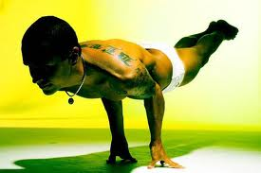
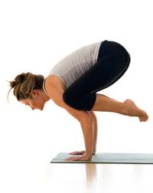
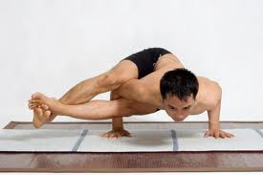
Balance
An even distribution of weight enabling someone or something to remain upright and steady.

Slide 26
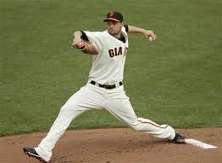
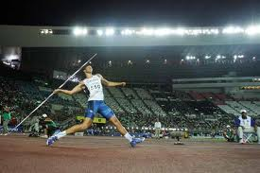
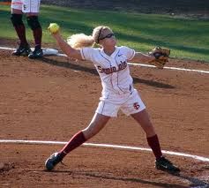
Opposition
The use of body parts on opposite sides of body to increase force and power.

Slide 27
1.5
Example: HSCII Motor Knowledge Standards
Which biomechanical principal is BEST described below?
When Karen throws the football, she steps with her left foot and throws with her right hand. Which principle of biomechanics is she displaying?
Force
Inertia
Rotary motion
Opposition

Slide 28
1.8
Example: HSCII Fitness Knowledge Standards
Ted wants to try out for the basketball team. What type of conditioning should he engage in to help him prepare?
Plyometrics
Combination of long distance running and sprints
Stretching and core strengthening
All of the above

Slide 29
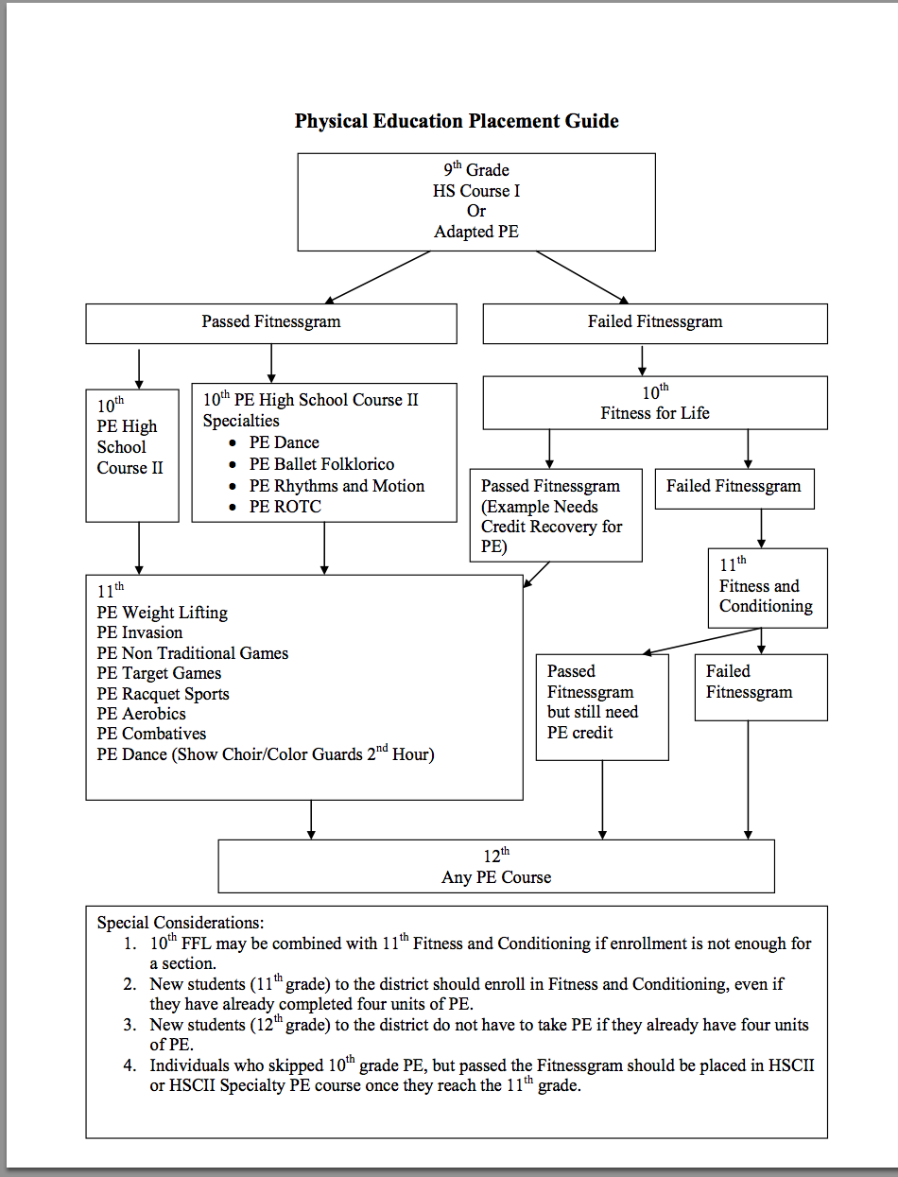

Slide 30
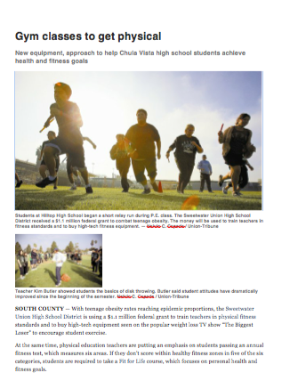
Visibility: News Release

Slide 31
Visibility: Teacher Resources

Slide 32
Visibility: District Employees

Slide 33
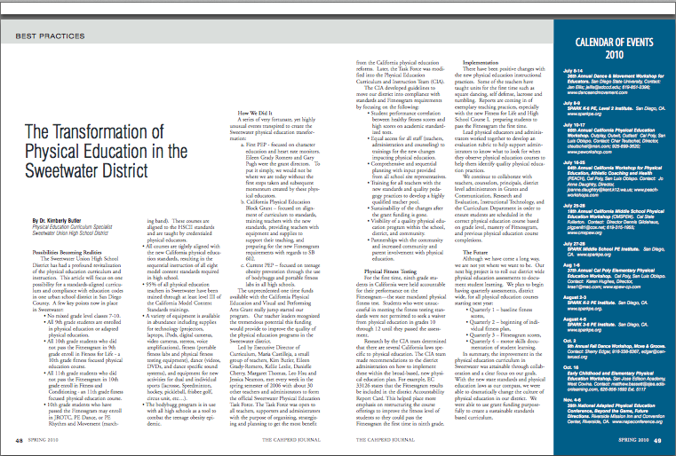
Visibility: CAHPERD

Slide 34
Visibility & District Support

Slide 35
District Level Support
"Big congratulations go out to the Sweetwater students, their families and physical education teachers who worked hard to adopt healthy habits for eating and exercise for our students," said Sweetwater school board president Jim Cartmill.
Sweetwater schools are changing the way health and physical fitness are taught with a new approach to physical education. Now 9th grade PE and 10th grade "Fit for Life" classes have replaced the emphasis on traditional team sports, athletic ability and competition with a focus on personal health and fitness goals.
"Student health is a top priority for the Sweetwater District," said Superintendent Dr. Jesus Gandara. "Fitness is an important component to learning.”

Slide 36
PEP Grant Results
Sustainability
Teachers trained in
SPARK
Model Content Standards
Fitnessgram protocol
Bodybuggs
Curriculum
Grade level, standards based
Baseline and Official PFT for all students
End of Course written assessments posted on district server/data used to inform future instruction
Fitnessgram results
2008 SUHSD 6 points below state scores
2011 SUHSD 20 points above state scores

Slide 37
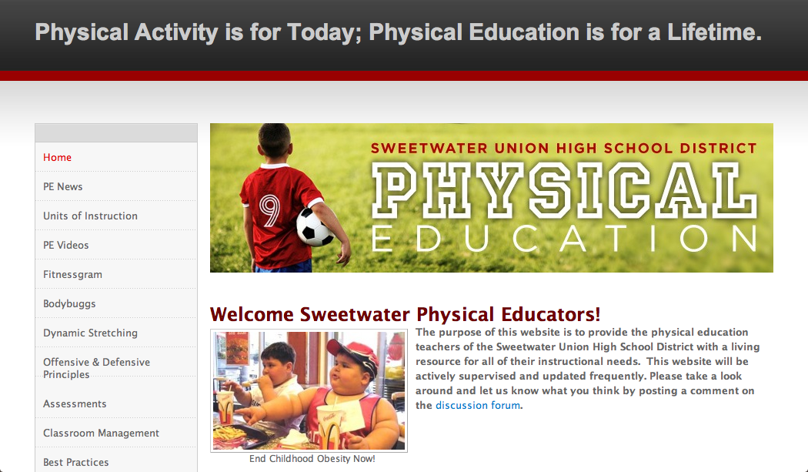
http://www.sweetwaterpe.org/

Slide 38
Contact Info
Dr. Kimberly Butler, NBCT
PEP Grant Director, Sweetwater Physical Education Curriculum Specialist
Phone: 619-585-6082
Email: kimberly.butler@sweetwaterschools.org
Danielle Cherry
Assistant PEP Grant Director
Email: danielle.cherry@sweetwaterschools.org
Allison Fletcher
Featured in “Exemplary Site Visits” from San Diego County Office of Education for her implementation of bodybuggs with the SPARK high school curriculum.
Email: allison.fletcher@sweetwaterschools.org
Sweetwater Physical Education Website: http://www.sweetwaterpe.org/

