Slide 1
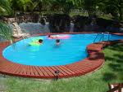
AQUATICS UNIT
BEACH and POOL SAFETY

Slide 2
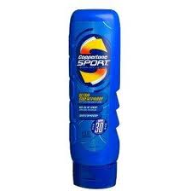
Wear Sunscreen!!
Why wear sun screen?
Dermatologists strongly recommend using a broad-spectrum (UVA and UVB protection) water-resistant sunscreen(sport) with an SPF of 30 or greater year-round for all skin types. This will help protect against sunburn, premature aging (e.g., age spots and wrinkles) and skin cancer.
SPF stands for Sun Protection Factor. Sunscreens are rated or classified by the strength of their SPF. The SPF numbers on the packaging can range from as low as 2 to greater than 50. These numbers refer to the product's ability to deflect the sun's burning rays.

Slide 3
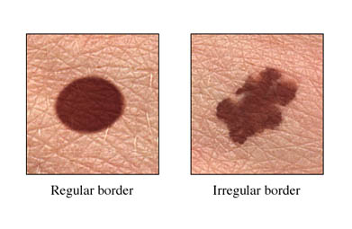
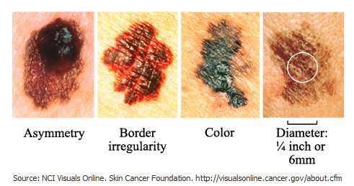
Despite increased awareness about the harmful effects of the sun, skin cancer is rising and more than ONE MILLION new cases will be diagnosed in the United States this year.
Ultraviolet (UV) radiation is thought to be the major risk factor for most skin cancers. Sunlight is the main source of UV radiation, which can damage the genes in your skin cells. Tanning lamps and booths are also sources of UV radiation.
Skin cancers are one result of getting too much sun, but there are other effects as well. The short-term results of unprotected exposure to UV rays are sunburn and tanning, which are signs of skin damage.
Long-term exposure can cause prematurely aged skin, wrinkles, loss of skin elasticity, dark patches (sometimes called age spots or liver spots), and pre-cancerous skin changes (such as dry, scaly, rough patches).
This is ok
This is Skin Cancer

Slide 4
Pool Safety Rules
No running on or around the pool deck.
No push or shoving.
Before diving or jumping in the pool make sure other’s are out of the way.
Only one person on the diving board at a time.
Never dive in areas that are not marked for diving (shallow water 1-6 feet)
It is estimated that approximately 800 spinal cord injuries happen each year from diving into a body of water. Approximately ¾ occur in the natural aquatic environment (lakes, ponds, streams, etc.) while the remaining amount occur in swimming pools. It is estimated that ninety percent of these incidents occur in water depths less than 6 feet.
If the weather turns bad (especially if there's lightning), you should get out of the pool immediately.
Do not go in the pool if a parent or life guard is not around.

Slide 5
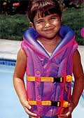
Swimming Aids
Arm Floaties
Vests

Slide 6
Swimming Aids
Kick Board
Noodles

Slide 7
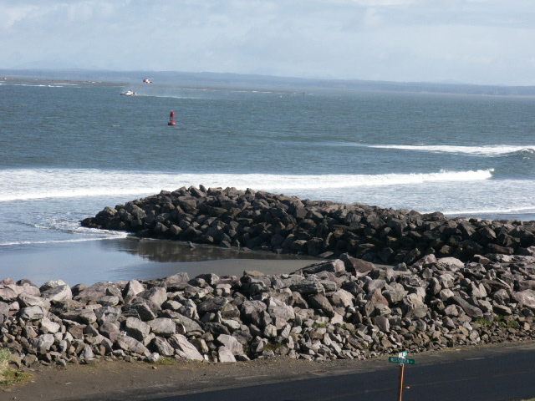
Ocean Safety
Not all beaches along the California coastline are recommended for swimming or wading. The very things that make these areas such spectacular places to look at and enjoy can be lethal to those caught unaware along the shoreline.
Large surf, cold water temperatures, backwash, sudden drop-offs, pounding shorebreak, and dangerous rip currents can turn what seem like safe activities such as playing near the surf line, wading, or climbing on rock outcroppings, deadly.
Stay off jetty’s and don’t swim by them or by a Pier. The current can drag you into the pillars or rocks and slam you into them.
There is limited lifeguard service along some portions of the coast. Check with on-duty park staff about the ocean conditions. Please be aware that conditions may change quickly along the coastline. When in doubt—don’t go out!

Slide 8
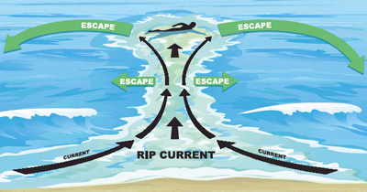
Rip Currents
Try to remain calm. Have someone spot the person in trouble or keep your eyes on the person. Give a clear explanation of your location and stay on the line with the dispatcher until you are told otherwise
Throw the rip current victim something that floats and yell instructions on how to escape by having the victim swim out of the rip current, in a direction following the shoreline. When out of the current, direct them to swim towards shore.
Only professionally trained rescuers should attempt in-water rescues.
Remember, many people drown while trying to save someone else from a rip current.
These are powerful, channeled currents of water flowing away from shore. They typically extend from the shoreline, through the surf zone, and past the line of breaking waves. Rip currents can occur at any beach with breaking waves or where a there is a stream or outflow into the surfline. The majority of ocean rescues made by lifeguards are due to victims struggling in rip currents.

Slide 9
Beach Rules
Never swim alone.
Be cautious at all times, especially when swimming at unguarded beaches. When in doubt, don’t go out!
Whenever possible, swim at a lifeguard protected beach.
Obey all instructions and orders from lifeguards.
If caught in a rip current, remain calm to conserve energy and think clearly.
Don’t fight the current. Swim out of the current in a direction following the shoreline. When out of the current, swim towards shore.
If you are unable to swim out of the rip current, float or calmly tread water. When out of the current, swim towards shore.
If you are still unable to reach shore, draw attention to yourself: face the shore, wave your arms, and yell for help.
If you see someone in trouble, get help from a lifeguard. If a lifeguard is not available, have someone call 9-1-1 . Throw the rip current victim something that floats and yell instructions on how to escape.

